Slide 1
ONLINE SHOPPING CART

Slide 2
OBJECTIVE
To provide an easy to use web based interface where users can search for products, view a complete description of the products and order the products.

Slide 3
Tech stack
Front End - React
React is used to create a interactive user interfaces and to design simple views
for each state of application.
Back End - Spring Boot
Spring Boot is used to create standalone applications that run on their own.
Database - MySQL

Slide 4
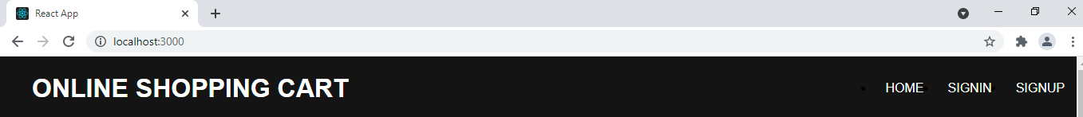
COMPONENTS
HEADER
It consists of 3 buttons HOME, SIGNIN and SIGNUP.

Slide 5
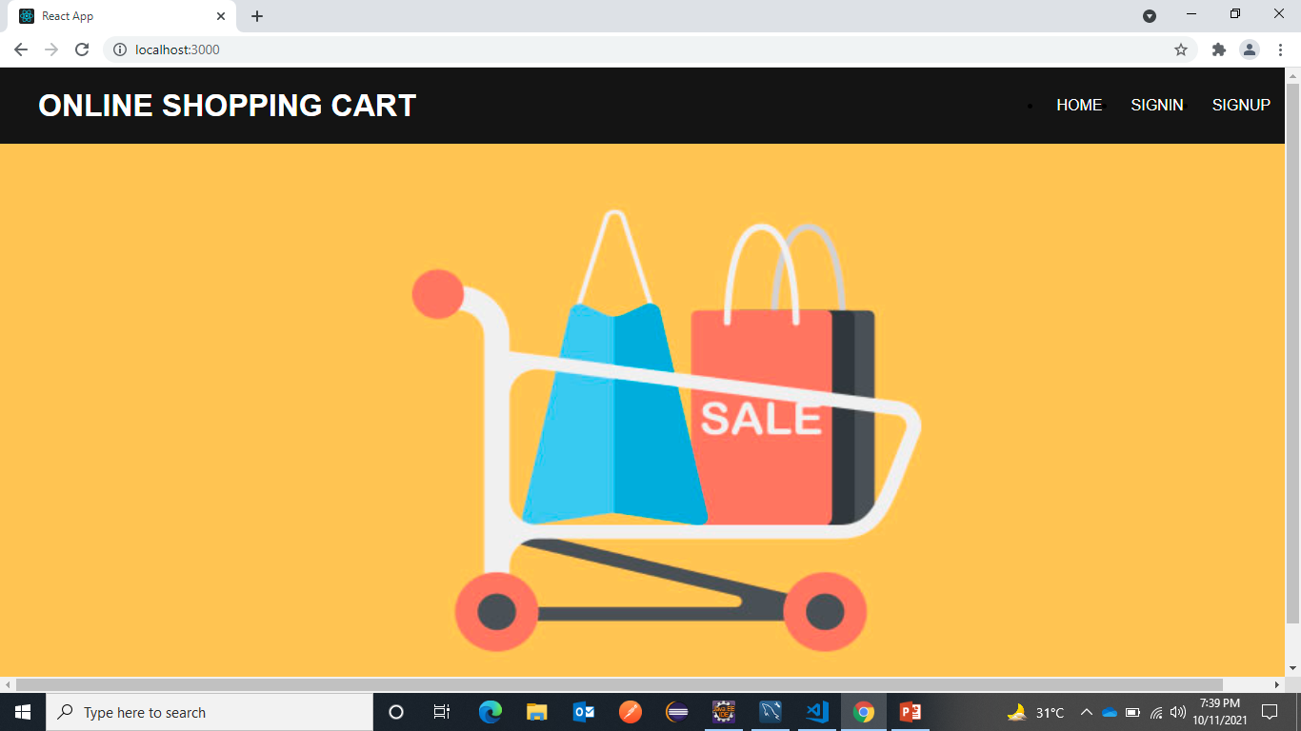
By clicking on HOME button user will navigate to HOME page of the application.

Slide 6
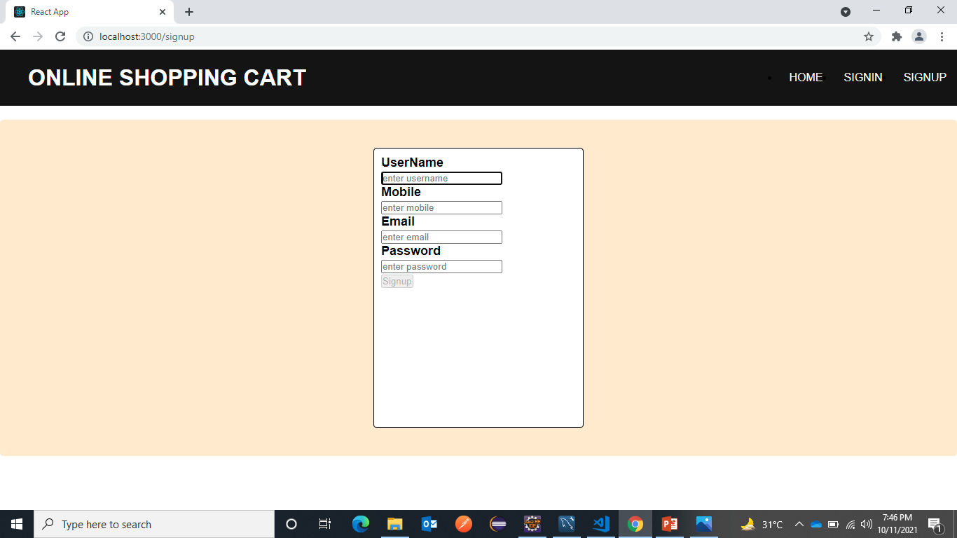
By clicking on SIGNUP button user will navigate to SIGNUP page where the user can enter his details and create an account in this online shopping cart.

Slide 7
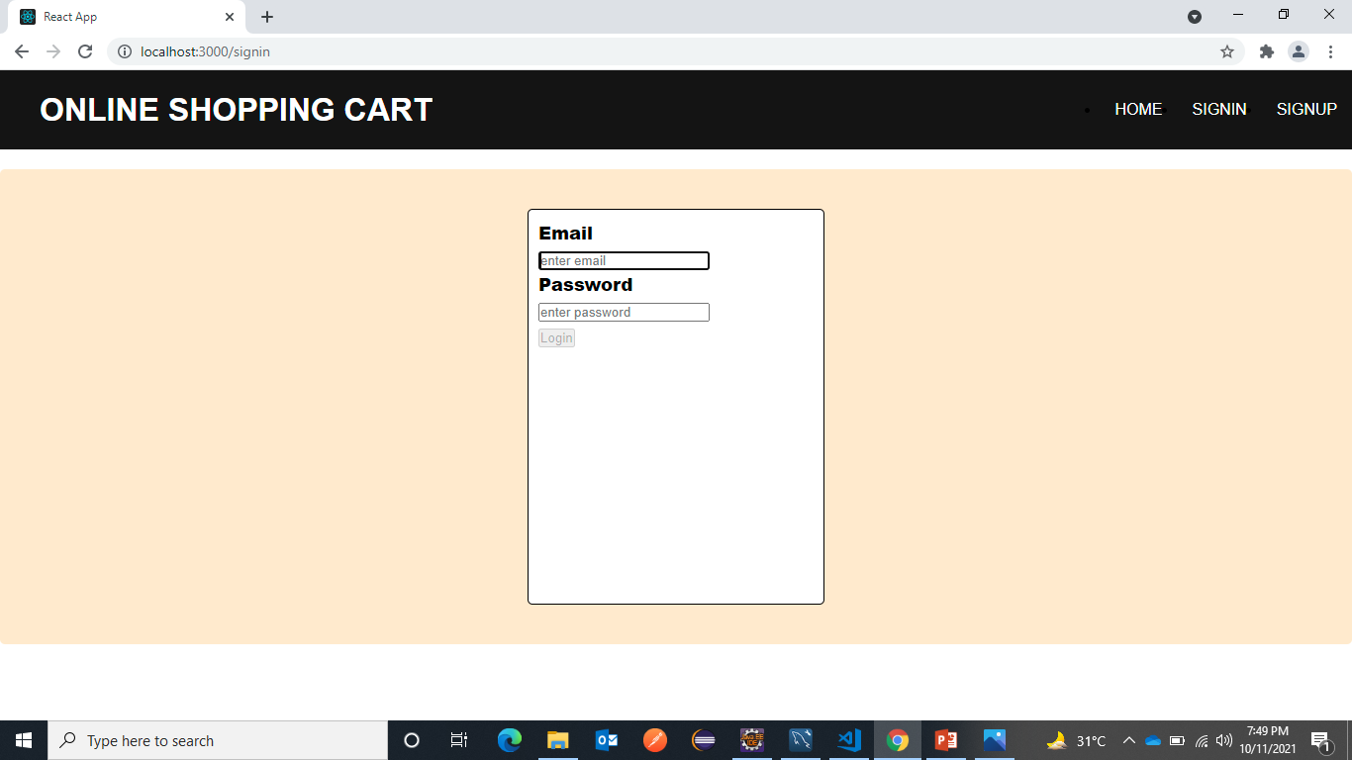
By clicking on SIGNIN button user will navigate to SIGNIN page from where user can login to his account.

Slide 8
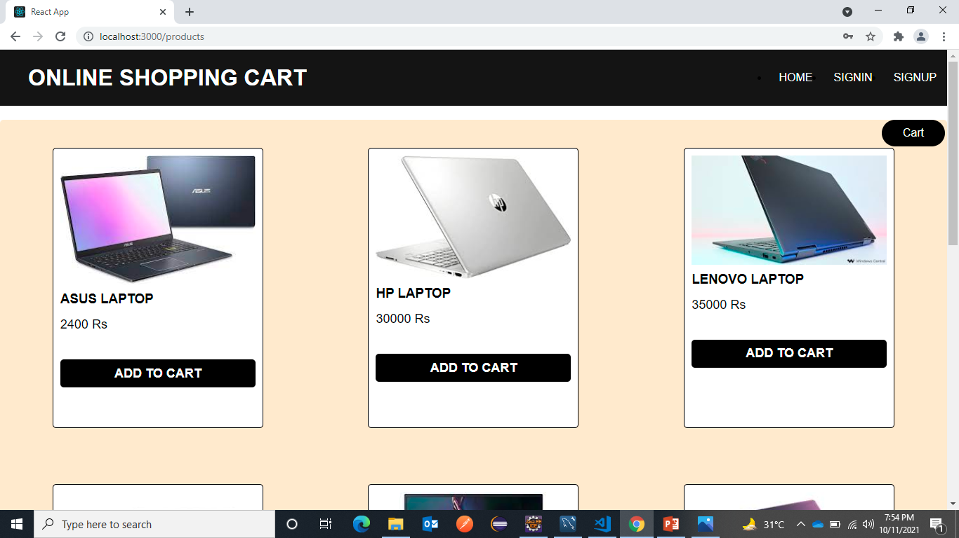
When a user gets logged into his account products page will be displayed where all the products are present and a user can add any item of his choice to the cart.

Slide 9
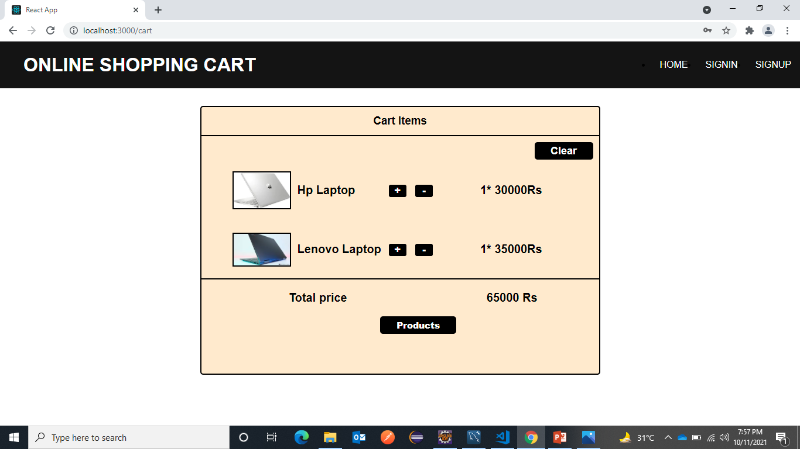
In products page by clicking on Cart button user can navigate to cart where he can see all the items that he has added to cart along with the details of the items and total price of the items . User can increase or decrease the quantity of each item based on his interest.

Slide 10
THANK YOU

